Slide 1
Oxford Safety Components Case Study February 2021

Slide 2
Project Details
Customer | Market leading fire solutions company
Location | South-East London
Product | CoverSafe Spark
Delivered In | February 2021

Slide 3
About the client
A UK market leader in passive fire protection, providing a ‘one-stop’ service which includes surveying, manufacturing, installation, certification and maintenance of fire doors, screens, fire alarm systems and other fire protection solutions.
An established and trusted provider across both the private and public sector. Their clients include housing and social care providers, public bodies, local authorities, maintenance contractors and private commercial clients.
From their base in South-East London, their manufacturing plant utilises specialist machinery to manufacture bespoke fire & enhanced security doors, screens & other products to the latest exacting standards.

Slide 4
Project Details
A market leading Fire Solutions company approached Oxford Safety Components in February 2021.
They had previously bought some CoverSafe Sparks from us before and had decided to go ahead and order a larger amount, as they found them very useful as an access platform and fall prevention system when installing fire barriers in attics/roof voids.
This is a great example of how the customer can often make us aware of sectors we previously hadn’t thought our products would apply to.

Slide 5
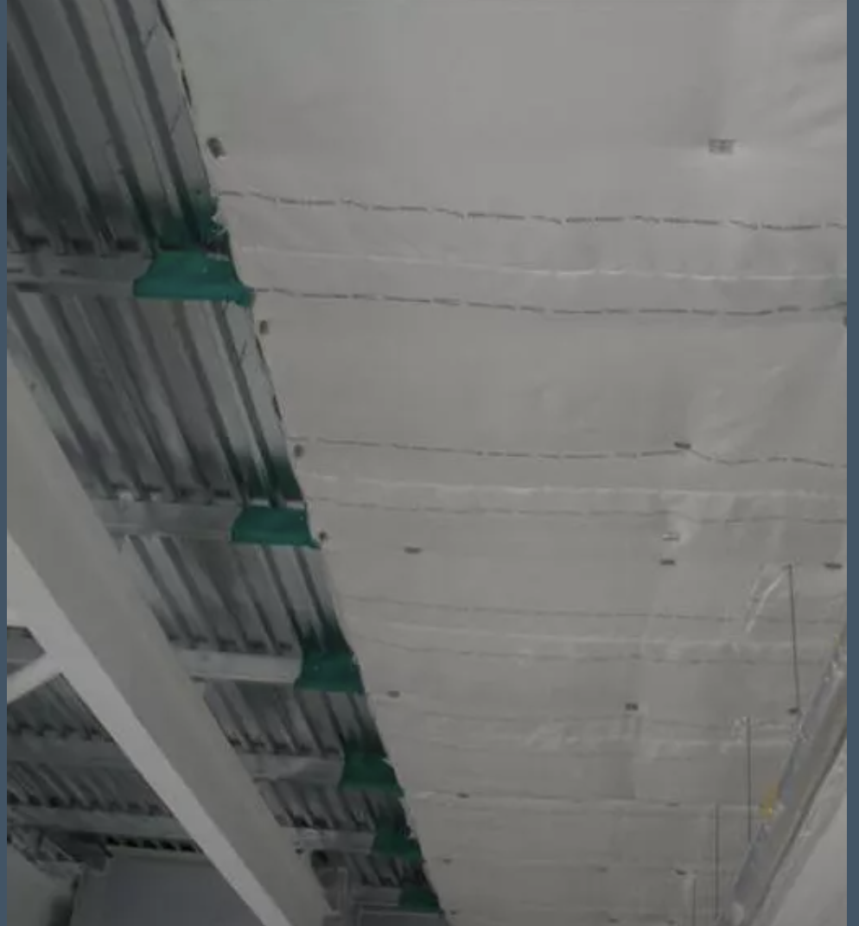
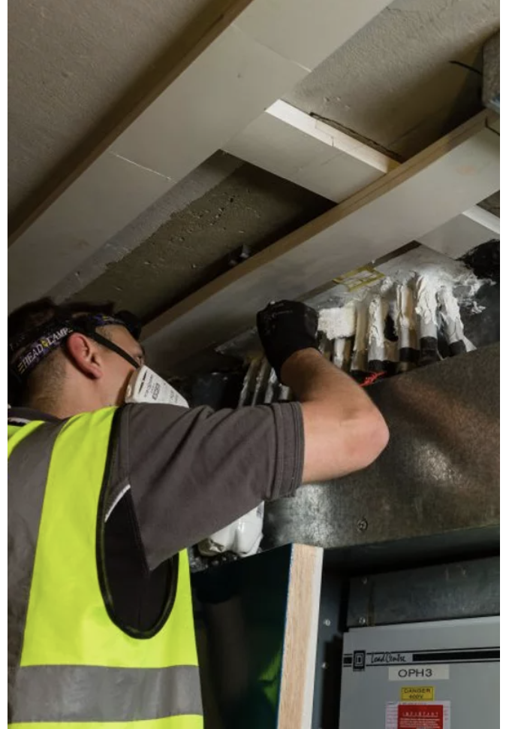
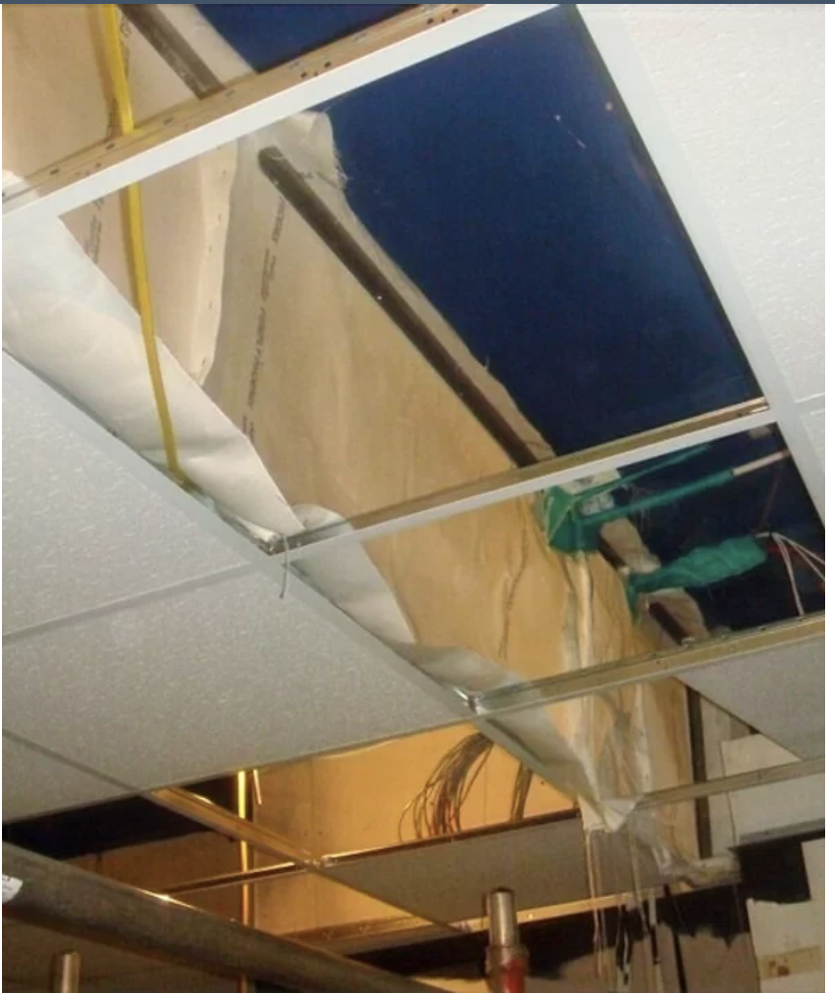
Project Images

Slide 6
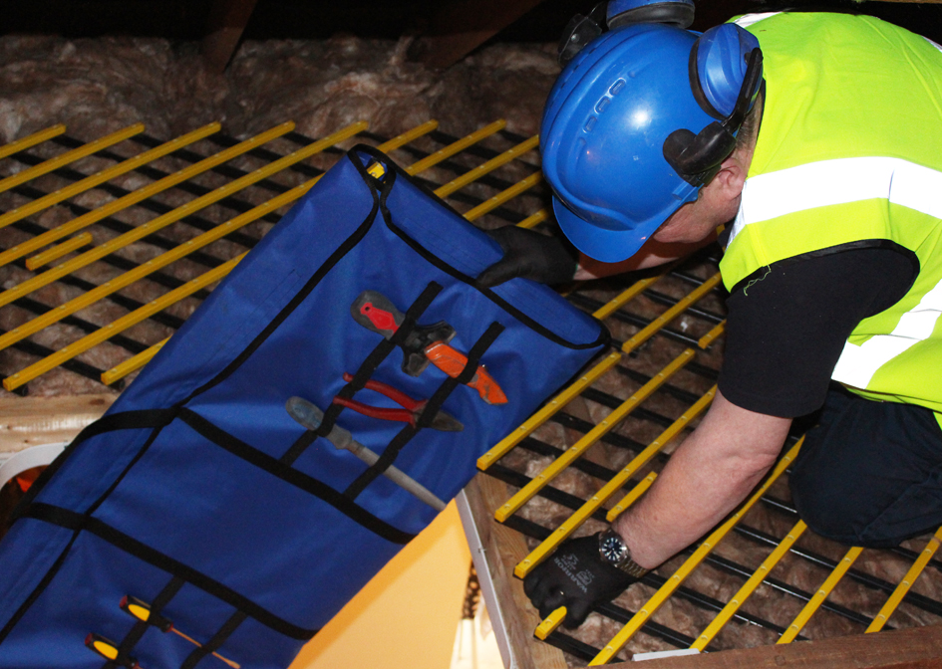
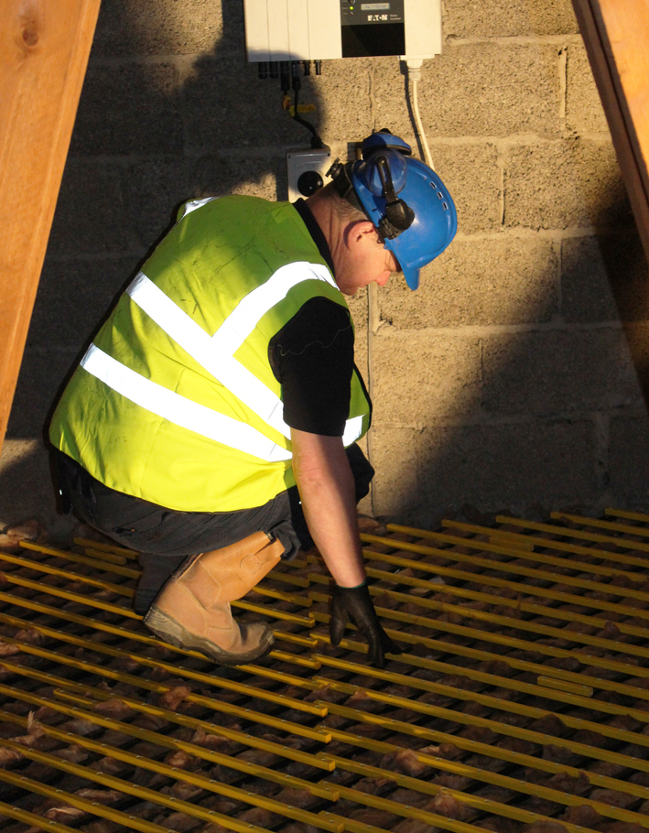
CoverSafe Spark

Slide 7
Oxford Safety Components
Tel: +44 (0) 1869323282
Email: sales@oxfordsafety.com
Website: www.oxfordsafety.com

