Slide 1
Oxford Safety Components –
CoverSafe Mat System Case Study
March 2020

Slide 2
Project Details
Customer:
Location:
Product:
Installation date:
Market leading construction business
Various locations
CoverSafe Mat System
Ongoing

Slide 3
Background
Our client is the nation’s largest housebuilder, creating great new places to live throughout Britain.
Their three consumer brands make up the heart of their business and offer a variety of properties across the UK. From stylish apartments in the city of London to luxury detached houses in the beautiful countryside.
Our client also has a commercial business, who are creating spaces from industrial and office buildings to retail and leisure.

Slide 4
Customer Problem
Our client was looking for a new working platform as they switched from the traditional block & brick build to a timber frame unit
The previously used ‘crash deck’ system wasn’t going to work for them anymore as it was
Time consuming to install & remove
Required installation teams to install & remove
Required large areas to store all components and several forklifts to load and remove
Work could not progress until the ‘crash deck’ was removed

Slide 5
Solution & Benefits to the customer
The Oxford Safety CoverSafe Mats were recommended to our by another construction business who have been using them successfully at their sites
Our client contacted Oxford Safety Components at the beginning of November 2019 and hired 75 x mats for a trial
A week later the 75 x mats were delivered and training was provided to operatives on site
After a successful 4 week trial, they placed an order to cover several sites in Scotland
The project is ongoing, Oxford Safety Components continue to receive orders from sites in Scotland and across the rest of the country

Slide 6
Solution & Benefits to the customer
Light-weight fall-prevention platform
The Safety Trellis Mats are easy to insert and expand (can be installed in minutes) to provide a safe temporary working platform
The mats are located on top of the truss cord therefore not impeding work
The mats are installed at ground level as the roof is built on the ground and then craned into position
Improve productivity by making a sturdy work platform when erecting truss roofs, felt and battening, roof tiling or any remedial tasks
After use, the mats are easily folded up and stored

Slide 7
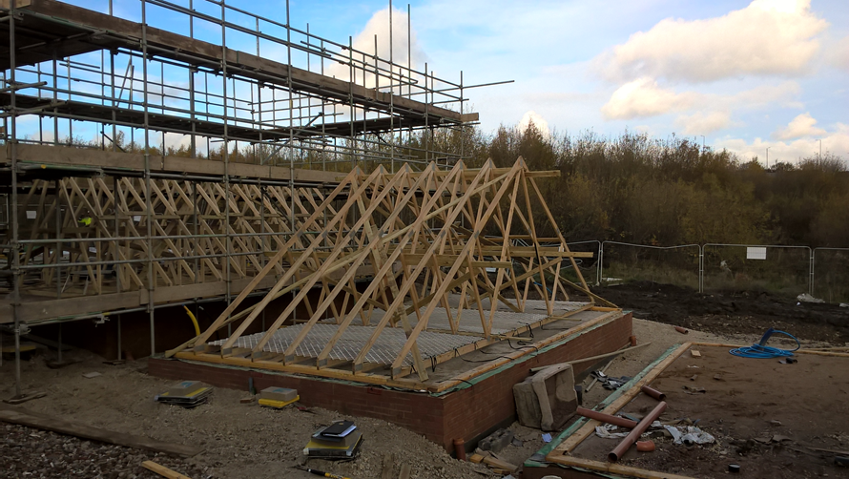
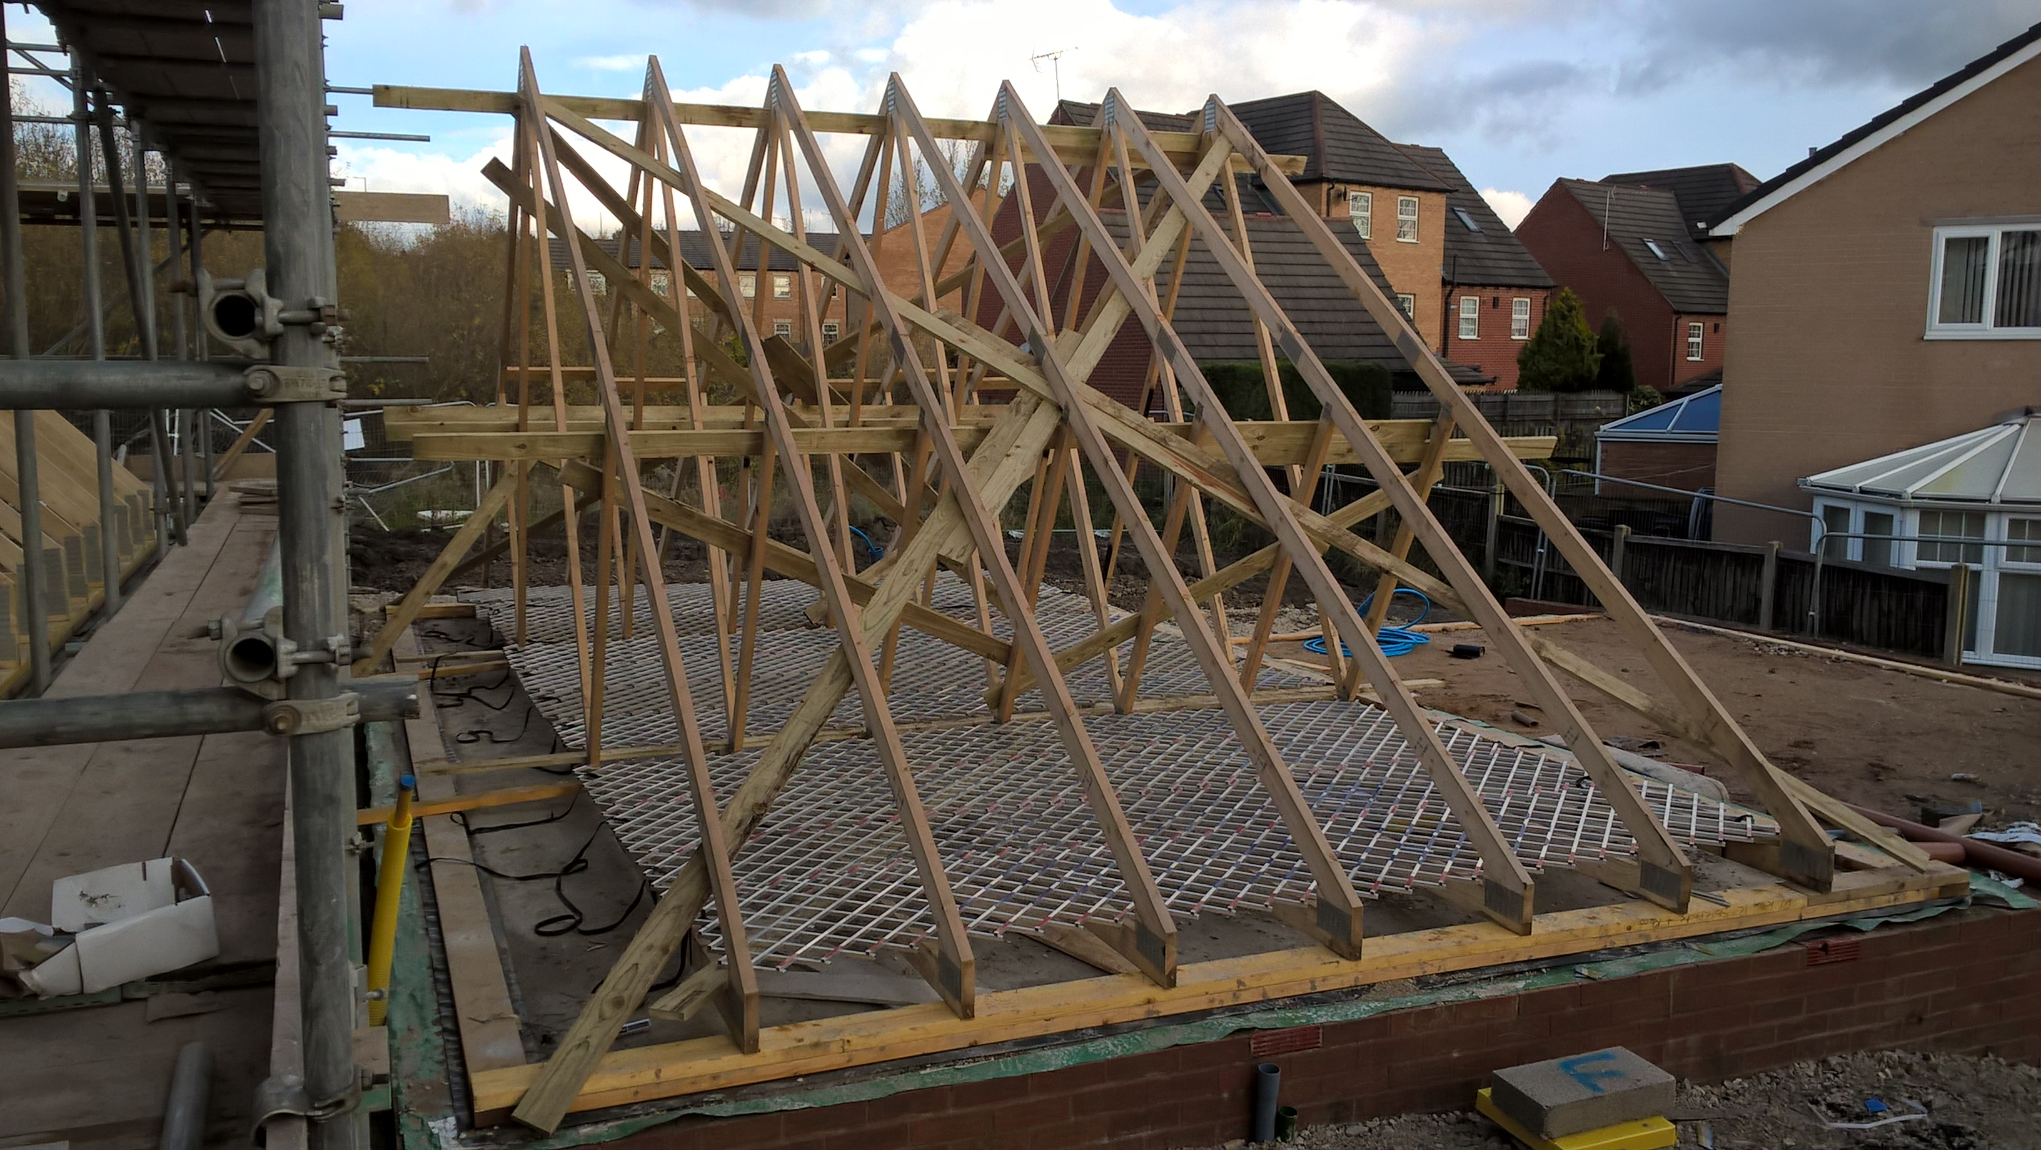
Photos

Slide 8
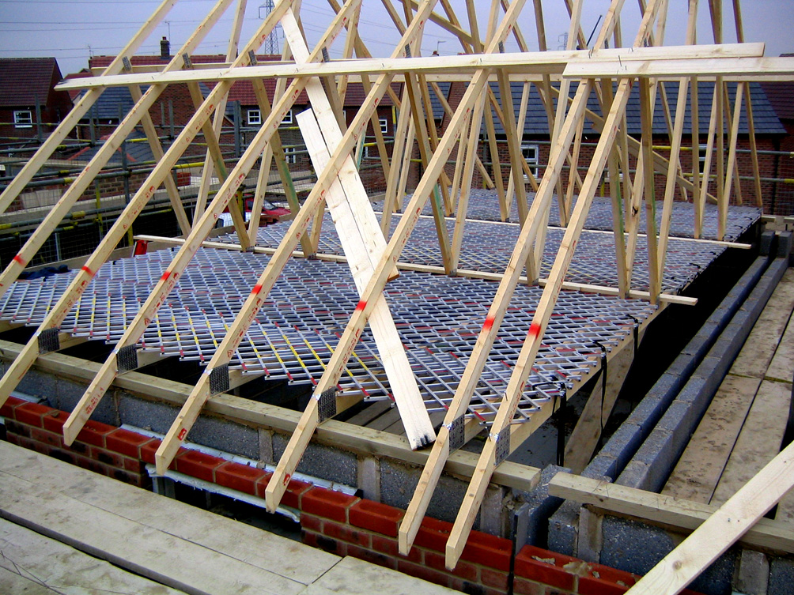
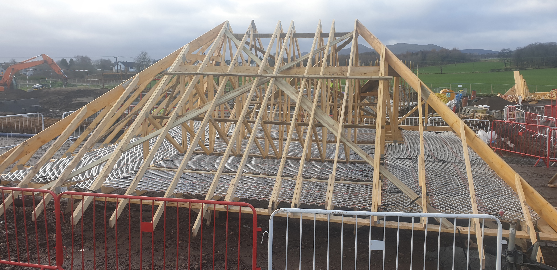
Photos

Slide 9
Oxford Safety Components
Tel: +44(0) 1869 32 32 82
Email: sales@oxfordsafety.com
Web: www.oxfordsafety.co.uk

